Slide 1
Gretel has gone out of the house.
Can you find her valuables and steal them and get out before she comes home?

Slide 2
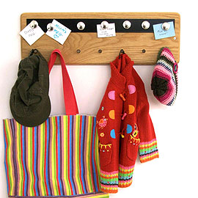
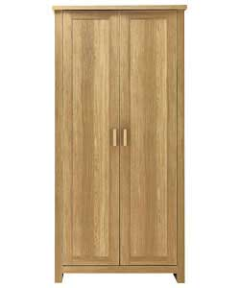
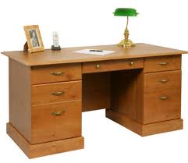
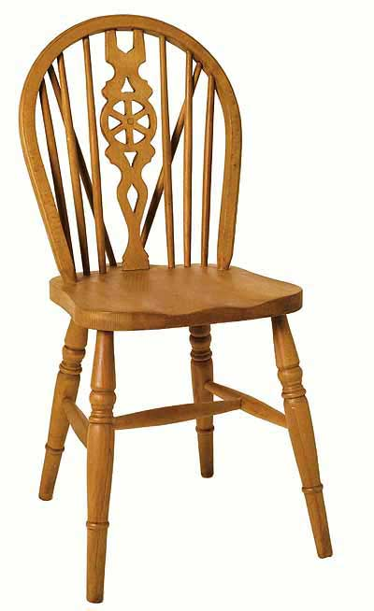
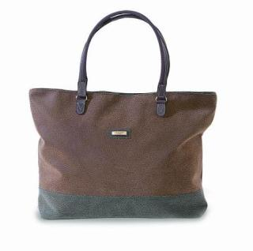
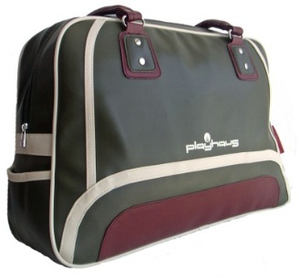

Slide 3
YOU FOUND HER WEDDING RING!
CLICK ME

Slide 4
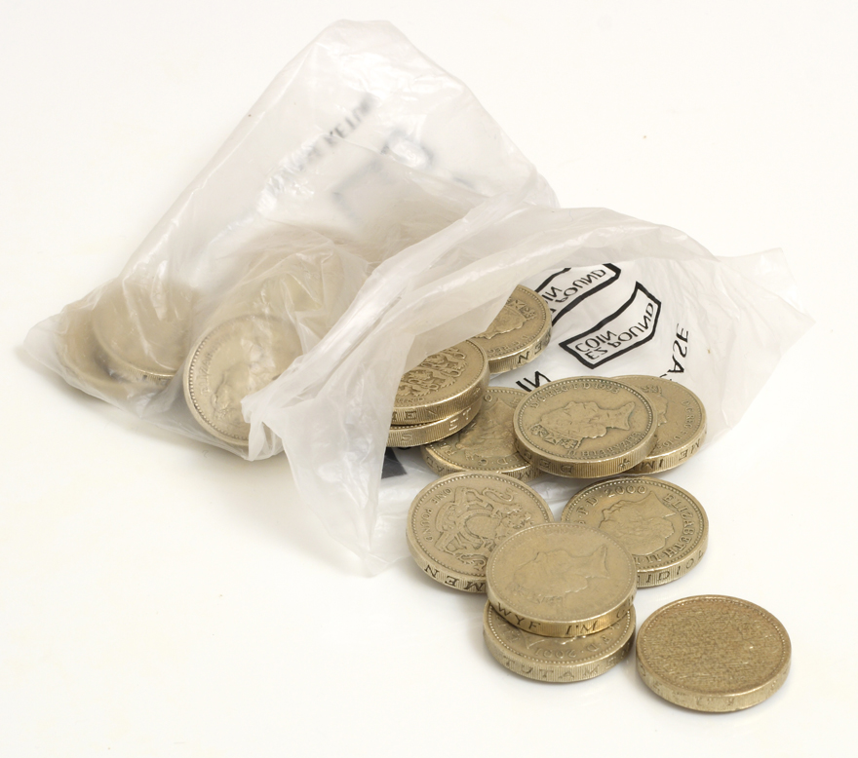
YOU FOUND SOME COINS!

Slide 5
YOU FOUND HER IPHONE!

Slide 6
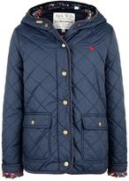
YOU FOUND HER JACK WILLS COAT!

Slide 7
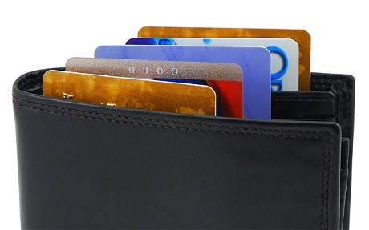
YOU FOUND HER WALLET!

Slide 8
Gretel’s coming – go go go!
Play again
quit
ROBBERY!!

